Slide 1
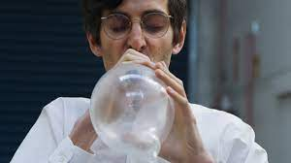
Chemistry and Pharmacology of Xenon
Shenvi Lab Group Meeting
By Dylan Snelson

Slide 2
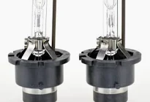

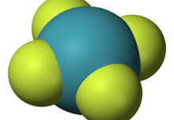

What is Xenon?
Nobel gas with a variety of applications in industrial settings and the medical field
Only noble gas that can form stable compounds
Only makes up .09 ppm of earths atmosphere! Highest abundance in our solar system is Jupiter
Unlike other noble Gases Xenon is not produced by nuclear fusion, but rather the fission of supernova explosion products

Slide 3
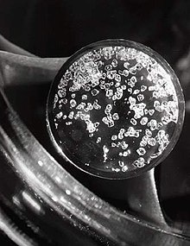
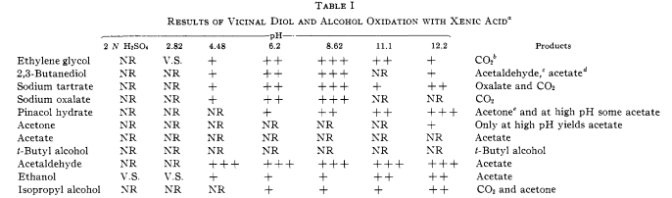
Chemistry of Xe
Xe can form stable halide and oxide compounds with XeF₄ being the most common and industrially relevant
Xe oxides are highly explosive, but XeO₃ can form a stable aqueous solution of xenic acid which is a powerful oxidant
Xenic acid oxidation has been explored in the 1960’s but little follow up on this work has been done
Propose a mechanism for oxidation of pinacol that could explain pH dependent product distribution

Slide 4
Chemistry of Xe Cont.
XeF₂ is powerful fluorinating agent and a good source of electrophilic fluorine
Useful for fluorination of aryl groups, and synthesis of 1,2 difluorinated compounds from alkenes
XeF₂ is also able to displace aryl silanes to form aryl fluorides, however electron donating substituents of the aryl ring can cause over fluorination

Slide 5
Chemistry of Xe Cont.
XeF₂ has applications in synthetic chemistry as a reagent used in decarboxylative fluorination back in 1986
Xe also forms stable clathrates with water, can be used in chemistry as a solvent under high pressure, as a tool for amplifying NMR signals on solid surfaces, and is used in protein crystallography to prevent phasing problems
Given the mechanism we have discussed, what are some potential applications of the proposed xenate ester intermediate

Slide 6


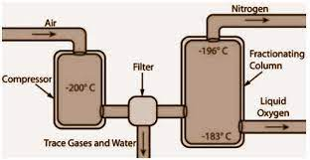
Xenon Applications in Medical Field
Xe is most widely used in the medical field as an anesthetic due to desirable pharmacological properties
Xe has also seen use as a PED in endurance sports as it increases red blood cell production
Recently, Xe has seen a surge in popularity as an agent for psychoactive substance assisted therapy
The limiting factor with use of Xe is difficulty and cost of acquisition
Before Xenon inhalation therapy
After Xenon inhalation therapy

Slide 7
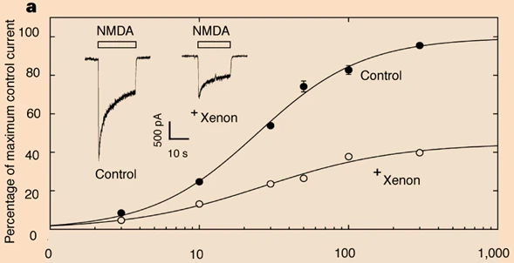
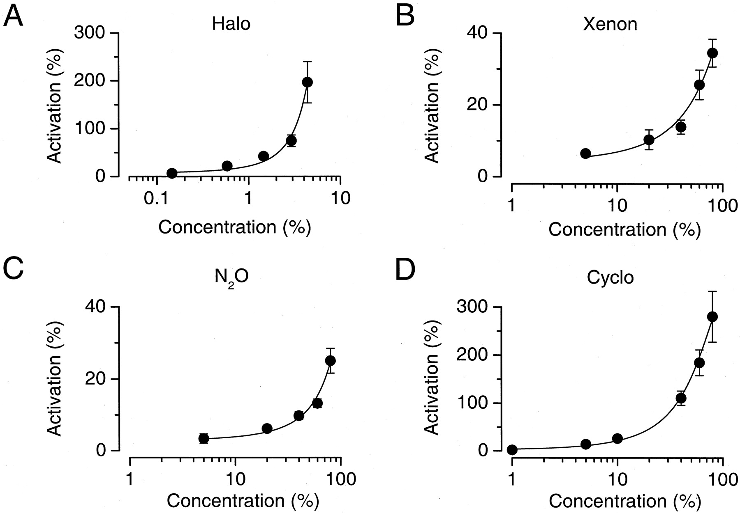
How Xe Works as an Anesthetic
Xe is an antagonist of the NMDA receptor believed to act at the glycine binding site
In addition to anesthetic properties, analgesia is another effect of Xe
Xe has also been shown to activate K+ channel TREK-1, which decreases neuronal excitability upon activation

Slide 8
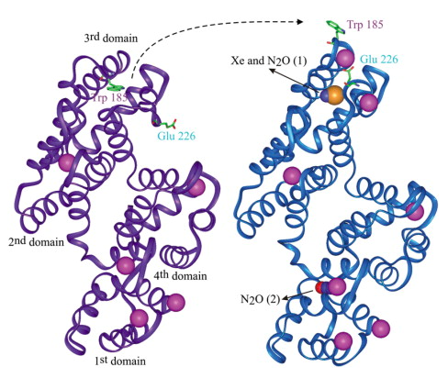
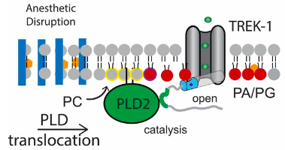
How Xe Works as an Anesthetic cont.
In a similar fashion to other inhaled anesthetics, Xe disrupts PLD2 binding to lipid rafts causing generation of PA, thus opening TREK-1
Crystal structure of Xe bound annexin V support the hypothesis that Xe selectively ligates the glycine binding region of NMDA receptors
While other receptors such as AMPA and 5-HT₃ have been shown to undergo Xe mediated inhibition there appears to be no resultant significant pharmacological response

Slide 9
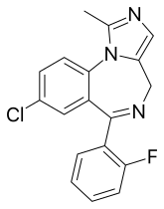
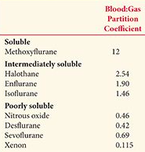
What Makes Xenon Different From Other Anesthetics?
Unlike other inhaled anesthetics, Xe has no impact of the GABA_{A} receptor lowering risk of interactions with preoperative compounds like midazolam
Xe has a significantly lower blood partition coefficient than other inhaled anesthetics
Xe has an intermediate potency relative to halogenated anesthetics and N₂O, but less side effects than those previously mentioned
Xe exhibits no fetotoxicity, does not undergo metabolism, and is environmentally friendly

Slide 10
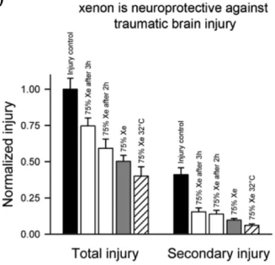
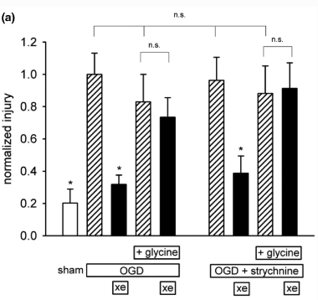
Neuroprotective Properties of Xenon
Over activation of the NMDA receptor has been linked to neuronal injury, and In Vitro study using Xe showed it prevented mechanical induced neuronal injury in mice treated with NMDA
Another study showed that Xe provided neuronal protection against oxygen-glucose deprivation induced injuries, and addition of glycine mitigated these neuroprotective effects. What other hypothesis about Xe does this result support?

Slide 11
“Solid Phase” Xenon
Attempts to make “solid phase” or orally available Xe have been made with the alpha-cyclodextrin complex, however storage requires a desiccated vessel and has other practical limitations
Other methods of trapping Xe in a supramolecular structure have been done, but these either suffer from instability in air, or rapid lose of bound Xe
Dosing variability of inhaled anesthetics makes it difficult to transition to an orally available form

Slide 12
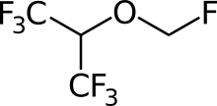
Closing Questions pt1
Provide a route to another inhaled anesthetic, sevoflurane incorporating one of the Xe mediated rxns discussed today
The reaction shown below of norbornane carboxylic acid and XeF₂ produced none of the expected fluorinated product, but instead gave the depicted ester. Even more intriguing, all the starting material was endo, yet the oxygen bound to norbornane in the product resides exclusively in the exo orientation. Provide a mechanism that could explain this product

Slide 13
Closing Questions pt 2
Should we replace all the Ar tanks in the lab with Xe?

